Slide 1

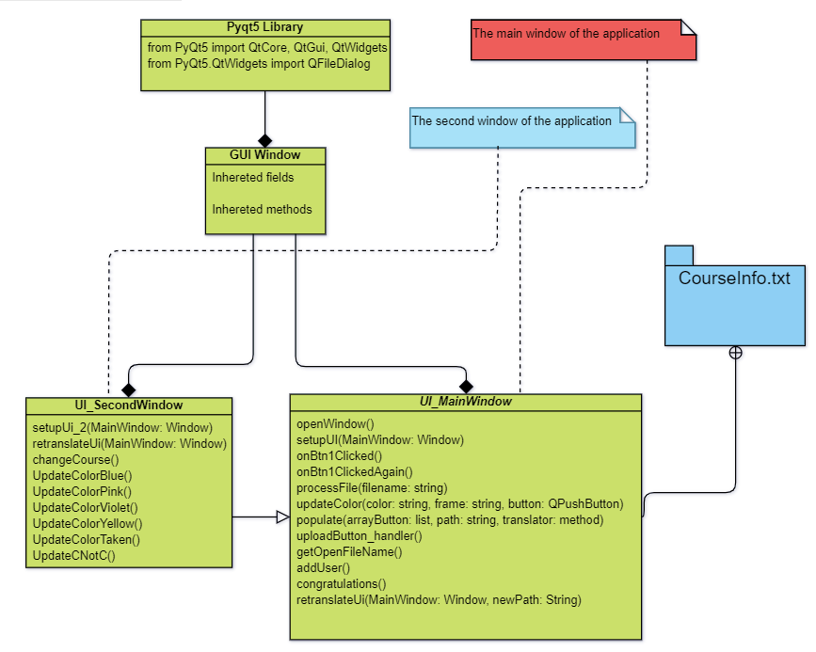
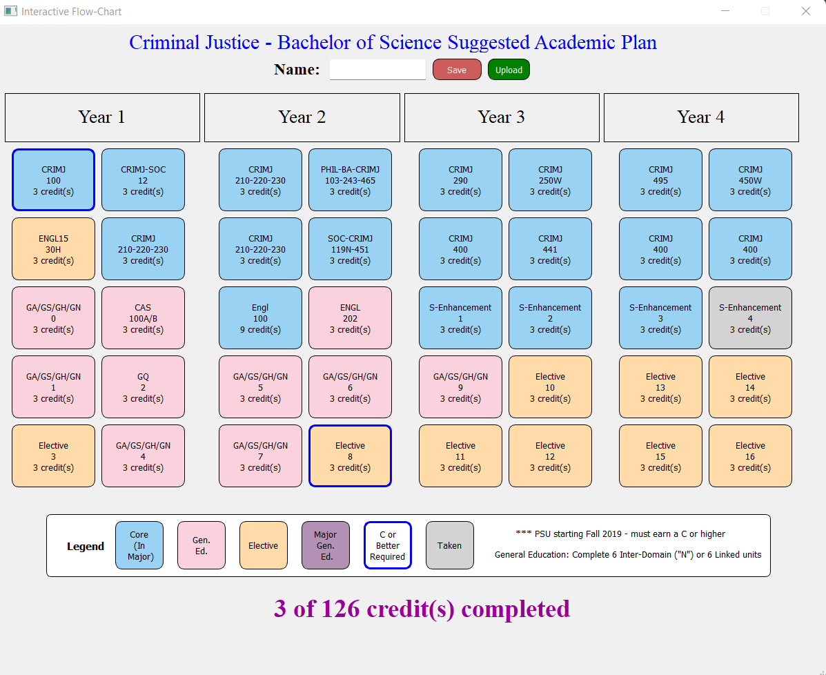
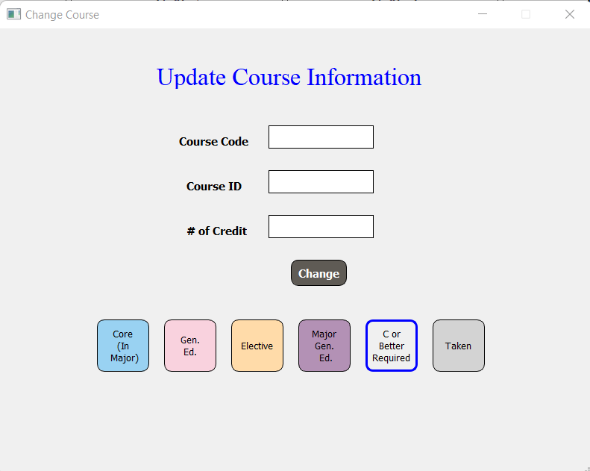

Interactive Flow-Chart
Class Diagram
Graphical User Interface
The frameworks, models and methodologies of software life cycle
The frameworks, models and methodologies of software life cycle
The Software Development Life Cycle (SDLC) involves several distinct stages, including planning, analysis, design, building, testing, deployment and maintenance.
In the Agile model, fast failure is a good thing. This approach produces ongoing release cycles, each featuring small, incremental changes from the previous release. At each iteration, the product is tested.
Planning :
We tried to figure out what was required for the project by meeting with the client.
We brainstormed different ways we could use to satisfy the project requirements and our client needs.
We came up with the idea to make it a web application but after discussing it further with our professor we switched it to a python application.
We set up deadlines for our work and set up other meetings with the client to get her feedback.
Analysis :
Came up with the idea to edit courses instead of just swapping them around.
Decided we need to create algorithms to populate our program, to process different files and to edit courses.
Created the class diagram for the project.
Design :
Decided that there will be two main windows for the program, main one and a second one for editing courses.
Finalized the look of the main window which is divided into 4 years and 10 courses for each year.
Building :
Each person had different methods to do by a certain timeline and we had iterations together to discuss the progress.
We had different demos to show to our client. With her feedback we managed to improve our design and software so it suits her needs.
Testing :
We did different types of testing like unit testing, integration and functional testing as we were working on the project. There were different bugs during the project that we identified from testing and fixed.
The final testing was the acceptance testing where the software had all the functionalities.
Deployment :
Created an executable and delivered it to the client.
Published github link for the project.
Maintenance:
Set up a contact with the client so for every problem she can contact us and we will work on it.
Penn State Abington
CMPSC 487W
SOFTWARE ENG DESIGN
Fall 2022
Dr. Alejandro Trofimoff
Worked by:
Hansi Seitaj, Eni Vejseli, Almaz Akhunbaev, Lukas Belashov
Poster
Notes:
https://docs.google.com/presentation/d/1xVc7-k6WqaVUYDdcwRTgSSwiFcDWBCrx/edit#slide=id.p1

